Slide 1
Simulating a Particle Tracker
Collaborative Software Development
Group F
Nils Hellerhoff
Benedikt Poggel
Julian Titze
Akshath Wikramanayake

Slide 2
Contents
Part 1
The reconstruction algorithm
Final results and testing
Implementation of the updated Requirements

Slide 3
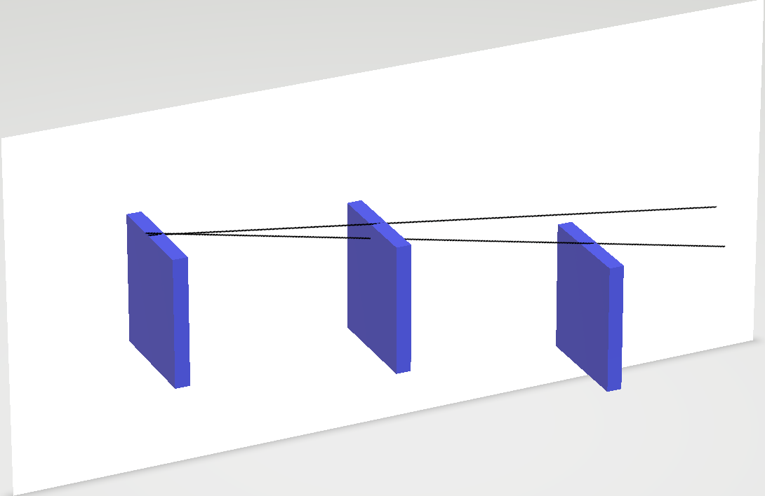
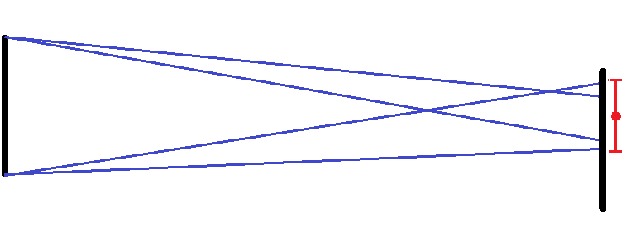
The Reconstruction Algorithm
Uses pixel data to calculate four extremum gradients
Top-to-top
Top-to-bottom
Bottom-to-top
Bottom-to-bottom
Successively narrows down gradients with each hit
Implement on the yz-plane and xz-plane to get x, y coordinates of approximate hit locations
Use singular value decomposition to obtain the reconstructed particle track

Slide 4
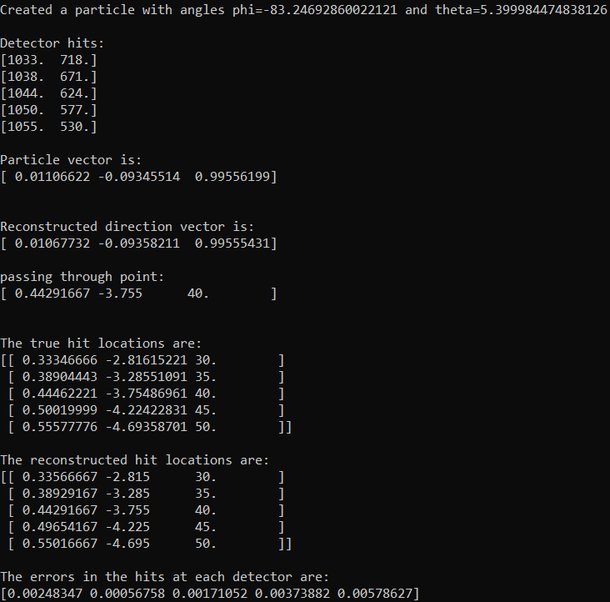
Final Results and Testing
Compare true hit location with intersection points between reconstructed vector and detectors
Errors are considerably smaller than the side length of a pixel
Errors at each detector appear to be uniform
Small standard deviation
Distance between true hit and reconstructed hit (μm) (n = 1000)
 | Detector 1 | Detector 2 | Detector 3 | Detector 4 | Detector 5
Average | 39.330 | 23.095 | 21.601 | 35.120 | 52.785
Standard dev | 14.985 | 10.838 | 10.646 | 18.039 | 28.307

Slide 5
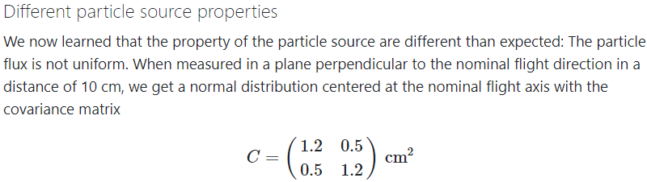
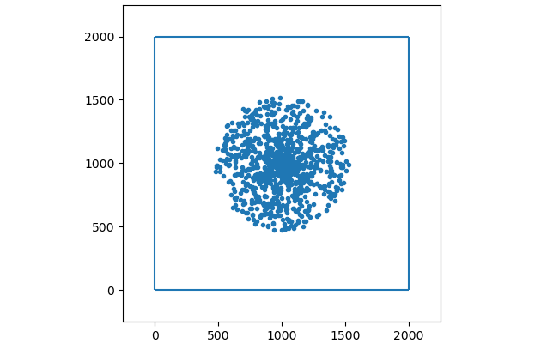
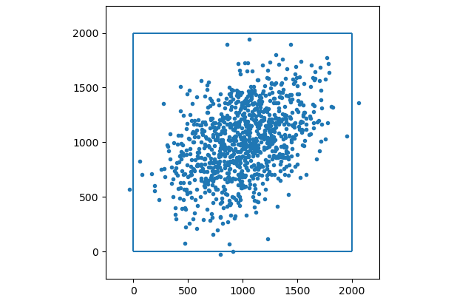
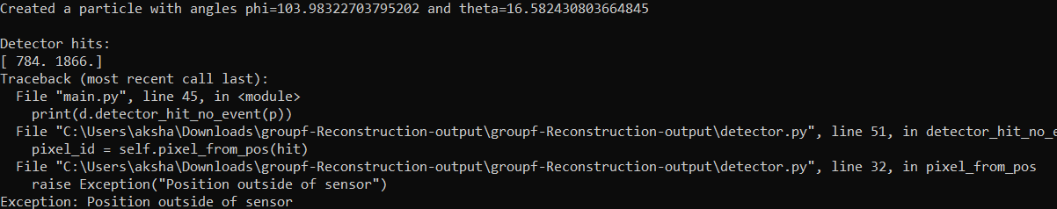
Updated Requirements
Source properties (uniform vs. normal distribution) can be chosen when calling the particle class
The specific covariance matrix can be chosen
Tracks from the source with a normal distribution do not always hit all the detectors
Exception raised when a track does not intersect all detectors
Further analysis should be done to determine whether tracks with less pixel data are precise enough to be useful

